Slide 1
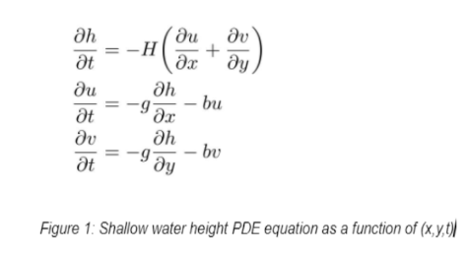
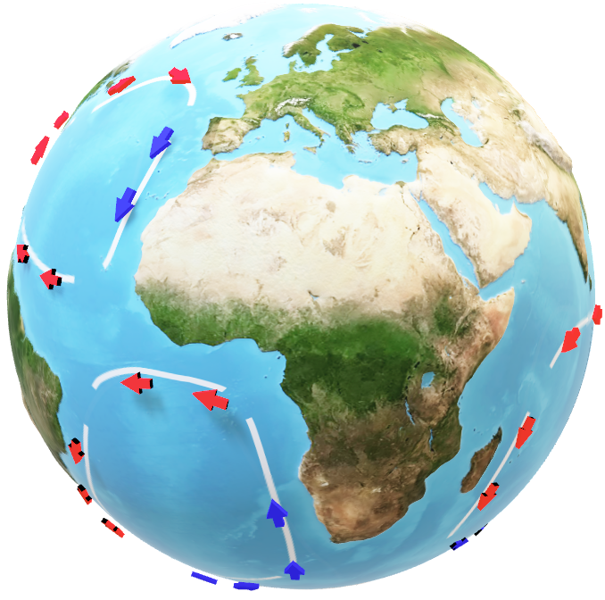
Shallow Water Numerical Method Comparison
Casey Bloomer and Fiona Powers
MSU Norm Asbjornson College of Engineering
Motivation & Overview
Heun’s Method
Analytic Solution
Results
Mitigating the effects of global warming using numerical methods and modeling derived from the Navier Stokes equations has yielded critical predictions and measurementations for ocean and atmospherics weather patterns.
Various numerical methods analyzed and observed though MATLAB investigation and data analysis allows the most time efficient, accurate, and reliable predation calculations for wave properties using the Shallow Wave Equations
Euler's Method
4th Order Runga-Kutta Method
Conclusion
Acknowledgements & Contributions

